Slide 1
COVID-19 RISK PREDICTOR
Team Evermore

Slide 2
Problem Statement

Slide 3
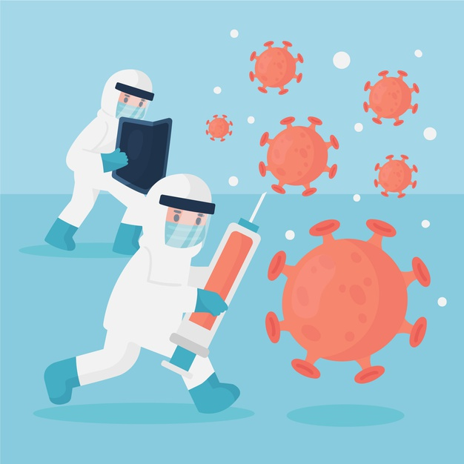
Problem Statement
Scientists have been trying to develop a vaccine ever since covid-19 became a pandemic. But, now that it is here one of the biggest challenges is the logistics.
In the initial stage vaccines produced will not be enough to meet the requirements of the entire population. Vaccines will be in short supply and so some people have to be prioritized over others. But what are the factors that we should consider?

Slide 4
Solution

Slide 5
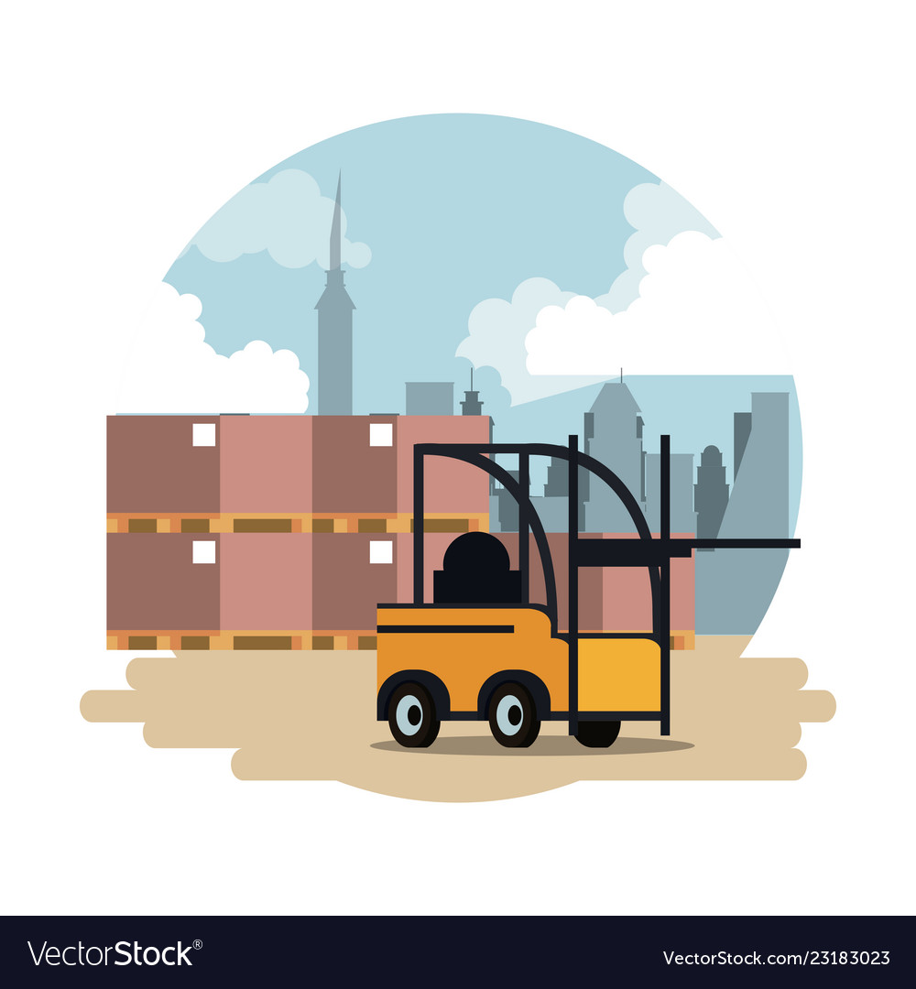
Solution
The solution we have come up with employs machine learning to make the best decision and also to eliminate natural human bias. We have also made a website which uses the trained model to act as the frontend for our project.
We use publicly available individual level data of people of various age groups and people with various pre-existing diseases to train our model to get the best possible performance and to generalize to a bigger population the best we can.

Slide 6
Prototype

Slide 7
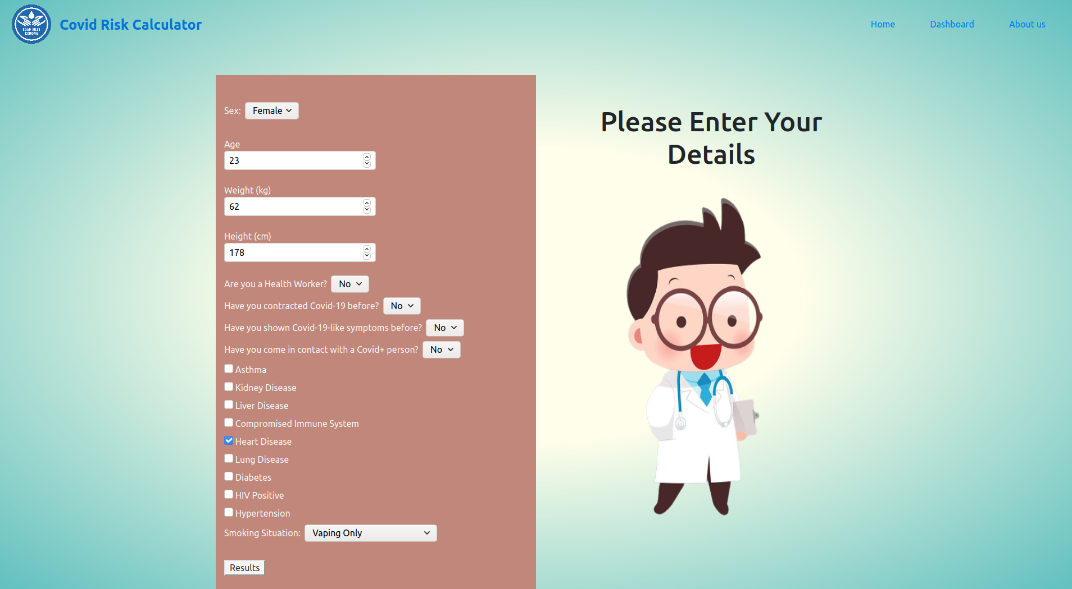
PROTOTYPE
In our website users can enter their details such as sex, age, weight, height, smoking history, disease history, COVID history. We then send a request to the backend i.e., fastAPI with these details. The trained model then predicts a risk factor using the given data. The model was trained using a Random Forest Regressor. The predicted risk factor is sent back to the website and displayed as one of 4 categories(Low risk, Medium Risk, High Risk, Very High Risk) to the user.

Slide 8
Challenges Faced

Slide 9

Challenges Faced
Finding a dataset that fit with our problem and pre-processing it for use was very time-consuming and a hassle.
Setting up the backend using fastAPI to interact with the website took us some time to learn and implement.
Collaborating with teammates over call was a challenge. But we are proud to have completed the project successfully.

Slide 10
Future Vision

Slide 11

FUTURE VISION
One of the first improvements would be to make this a mobile app for easy access.
The model can be improved with more individual level data from local health sources. The model can be made more relevant to India by collecting data from Indian health clinics.
The app could also be linked with government documents such as Aadhar to validate user’s details.

Slide 12
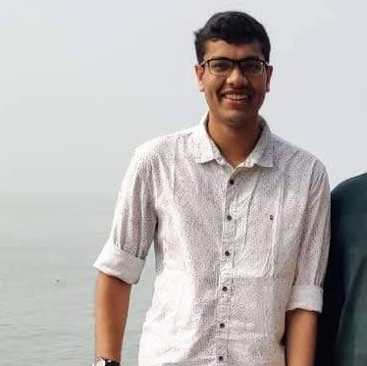
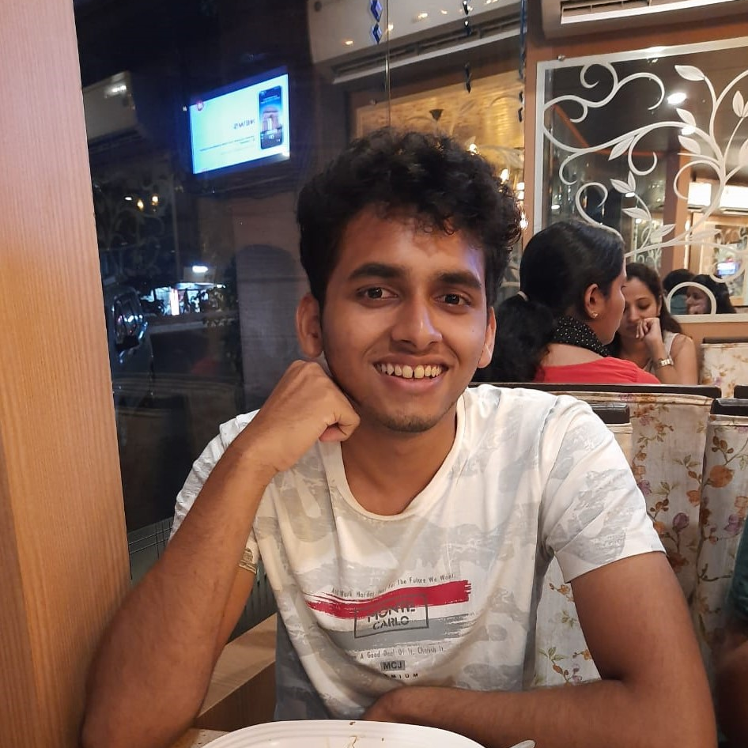
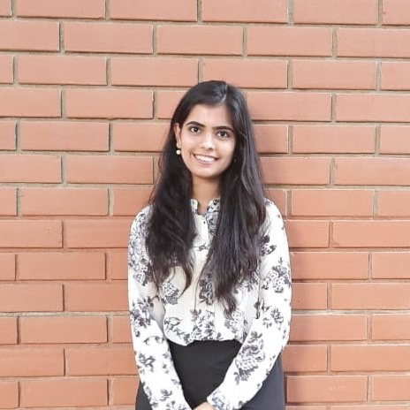
OUR TEAM
Agastya
Arnav
Simran

